Slide 1
Classification:Model Evaluation and Selection

Slide 2
Model Evaluation and Selection
Evaluation metrics: How can we measure accuracy? Other metrics to consider?
Use validation test set of class-labeled tuples instead of training set when assessing accuracy
Methods for estimating a classifier’s accuracy:
  Holdout method, random subsampling
  Cross-validation
  Bootstrap
Comparing classifiers:
  Confidence intervals
  Cost-benefit analysis and ROC Curves

Slide 3
Classifier Evaluation Metrics: Confusion Matrix
Confusion Matrix:
Actual class\Predicted class | C₁ | ¬ C₁
C₁ | True Positives (TP) | False Negatives (FN)
¬ C₁ | False Positives (FP) | True Negatives (TN)
Example of Confusion Matrix:
Actual class\Predicted class | buy_computer = yes | buy_computer = no | Total
buy_computer = yes | 6954 | 46 | 7000
buy_computer = no | 412 | 2588 | 3000
Total | 7366 | 2634 | 10000
Given m classes, an entry, CM_{i,j} in a confusion matrix indicates # of tuples in class i that were labeled by the classifier as class j
May have extra rows/columns to provide totals

Slide 4
Classifier Evaluation Metrics: Accuracy, Error Rate, Sensitivity and Specificity
A\P | C | ¬C
C | TP | FN | P
¬C | FP | TN | N
 | P’ | N’ | All
Class Imbalance Problem:
  One class may be rare, e.g. fraud, or HIV-positive
  Significant majority of the negative class and minority of the positive class
  Sensitivity: True Positive recognition rate
    Sensitivity = TP/P
  Specificity: True Negative recognition rate
    Specificity = TN/N
Classifier Accuracy, or recognition rate: percentage of test set tuples that are correctly classified
  Accuracy = (TP + TN)/All
Error rate: 1 – accuracy, or
  Error rate = (FP + FN)/All

Slide 5


Classifier Evaluation Metrics:
Precision and Recall
Precision: exactness – what % of tuples that the classifier labeled as positive are actually positive
Recall: completeness – what % of positive tuples did the classifier label as positive?
Perfect score is 1.0

Slide 6
Classifier Evaluation Metrics: Example
Actual Class\Predicted class | cancer = yes | cancer = no | Total | Recognition(%)
cancer = yes | 90 | 210 | 300
cancer = no | 140 | 9560 | 9700
Total | 230 | 9770 | 10000
  Precision
  Recall
Sensitivity
Specificity
Accuracy

Slide 7
Ex
Find Precision, Recall in respect of the following
Also find accuracy, sensitivity, selectivity. Is sensitivity same as recall? Also explore what is F-measure and calculate for the examples
Ex1 Suppose a computer program for recognizing dogs in scenes from a video identifies 7 dogs in a scene containing 9 dogs and some cats. If 4 of the identifications are correct, but 3 are actually cats.
Ex2 When a search engine returns 30 pages only 20 of which were relevant while failing to return 40 additional relevant pages

Slide 8
Ex
Find Precision, Recall in respect of the following
Also find accuracy, sensitivity, selectivity. Is sensitivity same as recall? Also explore what is F-measure and calculate for the examples
Ex1 Suppose a computer program for recognizing dogs in scenes from a video identifies 7 dogs in a scene containing 9 dogs and some cats. If 4 of the identifications are correct, but 3 are actually cats.
Ex2 When a search engine returns 30 pages only 20 of which were relevant while failing to return 40 additional relevant pages
1. The program's precision is 4/7 while its recall is 4/9.
2. Precision is 20/30 = 2/3 while its recall is 20/60 = 1/3.
So precision is "how useful the search results are", and recall is "how complete the results are".

Slide 9
Classifier Evaluation Metrics: Example
Actual Class\Predicted class | cancer = yes | cancer = no | Total | Recognition(%)
cancer = yes | 90 | 210 | 300 | 30.00 (sensitivity
cancer = no | 140 | 9560 | 9700 | 98.56 (specificity)
Total | 230 | 9770 | 10000 | 96.40 (accuracy)
  Precision = 90/230 = 39.13% Recall = 90/300 = 30.00%

Slide 10
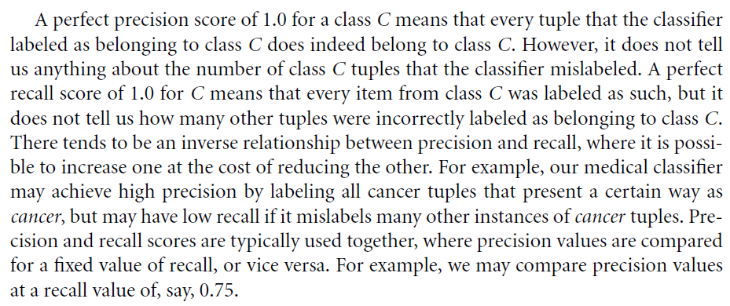
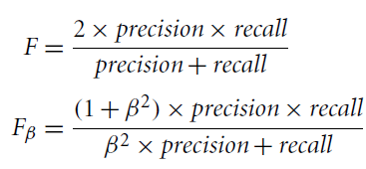
Precision Vs Recall
An alternative way to use precision and recall is to combine them into a single measure… F measure (also known as the F1 score or F-score) and the F beta measure

Slide 11
Precision Vs Recall
where is a non-negative real number. The F measure is the harmonic mean of precision and recall (proof - an exercise).
It gives equal weight to precision and recall. The F_{beta} measure is a weighted measure of precision and recall. It assigns beta times as much weight to recall as to precision.
Commonly used F measures are F2 (which weights recall twice as much as precision) and F0.5 (which weights precision twice as much as recall).

Slide 12
In summary
Discussed several evaluation measures. The accuracy measure works best when the data classes are fairly evenly distributed.
Other measures, such as sensitivity (or recall), specificity, precision, F, and F beta, are better suited to the class imbalance problem, where the main class of interest is rare.
Focus now on …obtain reliable classifier accuracy estimates.

Slide 13
An alternative way to use precision and recall is to combine them into a single measure… F measure (also known as the F1 score or F-score) and the F beta measure
It gives equal weight to precision and recall. The F beta measure is a weighted measure of precision and recall. It assigns beta times as much weight to recall as to precision. Commonly used F beta measures are F2 (which weights recall twice as much as precision) and F 0.5 (which weights precision twice as much as recall).

Slide 14
Precision and Recall
When evaluating a search tool or a classifier, we are interested in at least two performance measures:
Precision: Within a given set of positively-labeled results, the fraction that were true positives = tp/(tp + fp)
Recall: Given a set of positively-labeled results, the fraction of all positives that were retrieved = tp/(tp + fn)
Positively-labeled means judged “relevant” by the search engine or labeled as in the class by a classifier. tp = true positive, fp = false positive etc.

Slide 15
Be careful of “Accuracy”
The simplest measure of performance would be the fraction of items that are correctly classified, or the “accuracy” which is:
But this measure is dominated by the larger set (of positives or negatives) and favors trivial classifiers.
e.g. if 5% of items are truly positive, then a classifier that always says “negative” is 95% accurate.
tp + tn
tp + tn + fp + fn

Slide 16


The weighted “F” measure
A measure that naturally combines precision and recall is the β-weighted F-measure:
F =
Which is the weighted harmonic mean of precision and recall. Setting β = 1 gives us the F₁ – measure. It can also be computed as:

Slide 17
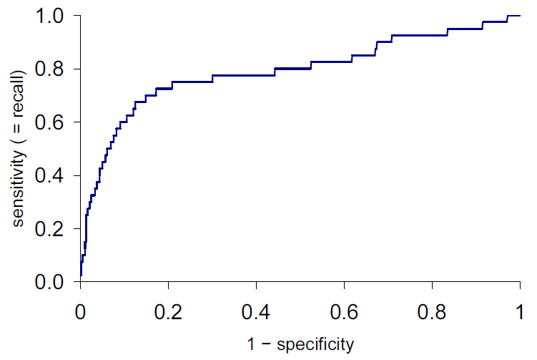
ROC plots
ROC is Receiver-Operating Characteristic. ROC plots
Y-axis: true positive rate = tp/(tp + fn), same as recall
X-axis: false positive rate = fp/(fp + tn) = 1 - specificity
Score increasing

Slide 18
ROC AUC
ROC AUC is the “Area Under the Curve” – a single number that captures the overall quality of the classifier. It should be between 0.5 (random classifier) and 1.0 (perfect).
Random ordering
area = 0.5

Slide 19
Lift Plot
A derivative of the ROC plot is the lift plot, which compares the performance of the actual classifier/search engine against random ordering, or sometimes against another classifier.
Lift is the ratio
of these lengths

Slide 20
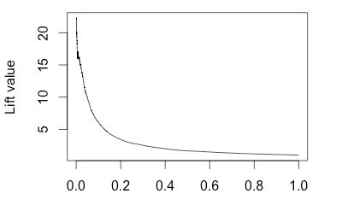
Lift Plot
Lift plots emphasize initial precision (typically what you care about), and performance in a problem-independent way.
Note: The lift plot points should be computed at regular spacing, e.g. 1/00 or 1/1000. Otherwise the initial lift value can be excessively high, and unstable.
1 - specificity

Slide 21
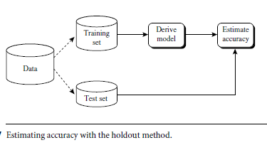
Evaluating Classifier Accuracy:
Holdout & Cross-Validation Methods
Holdout method
  Given data is randomly partitioned into two independent sets
    Training set (e.g., 2/3) for model construction
    Test set (e.g., 1/3) for accuracy estimation
  Random sampling: a variation of holdout. Repeat holdout k times, accuracy = avg. of the accuracies obtained

Slide 22
Evaluating Classifier Accuracy:
Holdout & Cross-Validation Methods
Cross-validation (k-fold, where k = 10 is most popular)
  Randomly partition the data into k mutually exclusive subsets, each approximately equal size
  At i-th iteration, use D_{i} as test set and others as training set
  each sample is used the same number of times for training and once for testing.
  In general 10-fold x-validation recommended for estimating accuracy

Slide 23
Evaluating Classifier Accuracy: Bootstrap
Bootstrap
  Works well with small data sets
  Samples the given training tuples uniformly with replacement
    i.e., each time a tuple is selected, it is equally likely to be selected again and re-added to the training set
Several bootstrap methods, and a common one is .632 boostrap
  A data set with d tuples is sampled d times, with replacement, resulting in a training set of d samples.
  The data tuples that did not make it into the training set end up forming the test set.
  About 63.2% of the original data end up in the bootstrap, and the remaining 36.8% form the test set (since (1 – 1/d)^{d} ≈ e⁻¹ = 0.368)

Slide 24
Issues Affecting Model Selection
Accuracy
  classifier accuracy: predicting class label
Speed
  time to construct the model (training time)
  time to use the model (classification/prediction time)
Robustness: handling noise and missing values
Scalability: efficiency in disk-resident databases
Interpretability
  understanding and insight provided by the model
Other measures, e.g., goodness of rules, such as decision tree size or compactness of classification rules

Slide 25
Student's' t Test
Technique for testing a hypothesis on the basis of a difference between sample means…. the t test determines a probability that two populations are the same with respect to the variable tested.
Ex
Data collected on the heights of male basketball and football players, and compared the sample means using the t test. A probability of 0.4 would mean that there is a 40% likelihood that you cannot distinguish a group of basketball players from a group of football players by height alone.
If you calculate a probability of 0.05 or less, then you can reject the null hypothesis (that is, you can conclude that the two groups of athletes can be distinguished by height.
Ex:
Leaves were collected and grown in shade/ full sun.
Thicknesses of 7 sun leaves were reported as: 150, 100, 210, 300, 200, 210, and 300.
The mean ± standard deviation for sun leaves was 210 ± 73
Thicknesses of 7 shade leaves were reported as 120, 125, 160, 130, 200, 170, and 200.
The mean ± standard deviation for shade leaves was158 ± 34.
For the t test for independent samples you do not have to have the same number of data points in each group. We have to assume that the population follows a normal distribution (small samples have more scatter and follow what is called a t distribution). Corrections can be made for groups that do not show a normal distribution

Slide 26
Two-sample t-test
Applied to compare whether the average difference between two groups is really significant or if it is due instead to random chance.

Slide 27


Estimating Confidence Intervals:
Classifier Models M₁ vs. M₂
Suppose we have 2 classifiers, M₁ and M₂, which one is better?
Use 10-fold cross-validation to obtain and
It may seem intuitive to select the model with the lowest error rate; however, these mean error rates are just estimates of error on the true population of future data cases
There can be considerable variance between error rates within any given 10-fold cross-validation experiment. Although the mean error rates obtained for M1 and M2 may appear different, that difference may not be statistically significant.
What if the difference between the 2 error rates is just attributed to chance?
  Use a test of statistical significance
  Obtain confidence limits for our error estimates

Slide 28
Estimating Confidence Intervals:
Null Hypothesis
Perform 10-fold cross-validation
Assume samples follow a t distribution with k–1 degrees of freedom (here, k=10)
Use t-test (or Student’s t-test)
Null Hypothesis: M₁ & M₂ are the same (Both are eqvt)
If we can reject null hypothesis, then
  we conclude that the difference between M₁ & M₂ is statistically significant
  Then choose the model with lower error rate

Slide 29


Estimating Confidence Intervals: t-test
If only 1 test set available: pair wise comparison
  For i^{th} round of 10-fold cross-validation, the same cross partitioning is used to obtain err(M₁)_{i} and err(M₂)_{i}
  Average over 10 rounds to get
  t-test computes t-statistic with k-1 degrees of freedom:
If two test sets available: use non-paired t-test
and
where
where
where k₁ & k₂ are # of cross-validation samples used for M₁ & M₂, resp.

Slide 30


Estimating Confidence Intervals:
Table for t-distribution
Symmetric
Significance level, e.g., sig = 0.05 or 5% means M₁ & M₂ are significantly different for 95% of population
Confidence limit, z = sig/2

Slide 31
Estimating Confidence Intervals:
Statistical Significance
Are M₁ & M₂ significantly different?
  Compute t. Select significance level (e.g. sig = 5%)
  Consult table for t-distribution: Find t value corresponding to k-1 degrees of freedom (here, 9)
  t-distribution is symmetric: typically upper % points of distribution shown → look up value for confidence limit z=sig/2 (here, 0.025)
  If t > z or t < -z, then t value lies in rejection region:
    Reject null hypothesis that mean error rates of M₁ & M₂ are same
    Conclude: statistically significant difference between M₁ & M₂
  Otherwise, conclude that any difference is chance

Slide 32
Model Selection T Test
Null Hypothesis: Both Models are same
 | M1 |  | M2 |  | M1-M2
1 | 2 |  | 4 |  | 2
2 | 3 |  | 5 |  | 2
3 | 4 |  | 2 |  | -2
4 | 2 |  | 7 |  | 5
5 | 1 |  | 9 |  | 8
6 | 5 |  | 10 |  | 5
7 | 4 |  | 8 |  | 4
8 | 8 |  | 7 |  | -1
9 | 10 |  | 9 |  | -1
10 | 9 |  | 5 |  | -4
10 | 4.8 |  | 6.6 |  | 14.17778
Num | 1.8 |  |  | Denom | 1.190705
 |  | t | 1.51171
sig =.05 | z=.025 | T-chart at (10-1) dof |  | 2.262
 |  | z
 |  | Case 1= t less than 2.262 ie |  |  | Both models same

Slide 33
Model Selection T Test
Null Hypothesis: Both Models are same
 | M1 |  | M2 |  | M1-M2
1 | 2 |  | 8 |  | 6
2 | 3 |  | 5 |  | 2
3 | 4 |  | 9 |  | 5
4 | 2 |  | 7 |  | 5
5 | 1 |  | 9 |  | 8
6 | 5 |  | 10 |  | 5
7 | 4 |  | 8 |  | 4
8 | 8 |  | 7 |  | -1
9 | 10 |  | 9 |  | -1
10 | 9 |  | 8 |  | -1
10 | 4.8 |  | 8 |  | 10.62222
Num | 3.2 |  |  | Denom | 1.030642
 |  | t | 3.104862
sig =.05 | z=.025 | T-chart (10-1) dof (9) |  | 2.262
 |  | Case = t >2.262 |  |  | Both models NOT same
 |  | Choose M1

Slide 34
Model Selection: ROC Curves

Slide 35
ROC Curves
The true positives, true negatives, false positives, and false negatives are also useful in assessing the costs and benefits (or risks and gains) associated with a classification model.
The cost associated with
  FN (such as incorrectly predicting that a cancerous patient is not cancerous) is far greater than those of a
  FP (incorrectly yet conservatively labeling a noncancerous patient as cancerous).
In such cases, we can outweigh one type of error over another by assigning a different cost to each. These costs may consider the danger to the patient, financial costs of resulting therapies, and other hospital costs.
Similarly, the benefits associated with a true positive decision may be different than those of a true negative.
Up to now, to compute classifier accuracy, assumed equal costs and essentially divided the sum of TP and TN by the total number of test tuples.

Slide 36
ROC Curves
For a two-class problem, an ROC curve allows us to visualize the trade-off between the rate at which the model can accurately recognize positive cases versus the rate at which it mistakenly identifies negative cases as positive for different portions of the test set.
Any increase in TPR occurs at the cost of an increase in FPR. The area under the ROC curve is a measure of the accuracy of the model.
To plot an ROC curve for a given classification model, M, the model must be able to return a probability of the predicted class for each test tuple.
With this information, we rank and sort the tuples so that the tuple that is most likely to belong to the positive or “yes” class appears at the top of the list, and the tuple that is least likely to belong to the positive class lands at the bottom of the list.
Naive Bayesian and back-propagation classifiers return a class probability distribution for each prediction and, therefore, are appropriate.

Slide 37
ROC Curves
Let the value that a probabilistic classifier returns for a given tuple X be f(X) -> [0, 1].
For a binary problem, a threshold t is typically selected so that tuples where f (X) >= t are considered positive and all the other tuples are considered negative. Note that the number of true positives and the number of false positives are both functions of t , so that we could write TP(t) and FP(t) . Both are monotonic descending functions.
general idea behind plotting an ROC curve
The vertical axis of an ROC curve represents TPR. The horizontal axis represents FPR. To plot an ROC curve for M, we begin as follows.
Starting at the bottom left corner (where TPR =FPR = 0), we check the tuple’s actual class label at the top of the list. If we have a true positive (i.e., a positive tuple that was correctly classified), then TP and thus TPR increase. On the graph, we move up and plot a point.
If, instead, the model classifies a negative tuple as positive, we have a false positive, and so both FP and FPR increase. On the graph, we move right and plot a point.
This process is repeated for each of the test tuples in ranked order, each time moving up on the graph for a true positive or toward the right for a false positive.

Slide 38
ROC Curves
ROC (Receiver Operating Characteristics) curves: for visual comparison of classification models
Originated from signal detection theory
Shows the trade-off between the true positive rate and the false positive rate

Slide 39
ROC Curves
TPR is the proportion of positive (or “yes”) tuples
that are correctly labeled by the model;
FPR is the proportion of negative (or “no”) tuples that are mislabeled as positive.
Given that TP, FP, P, and N are the number of true positive, false positive, positive, and negative tuples, respectively, we know that
  TPR = TP/P , which is sensitivity.
  Furthermore, FPR = FP/N , which is 1 - specificity.

Slide 40

Model Selection: ROC Curves
The area under the ROC curve is a measure of the accuracy of the model
Rank the test tuples in decreasing order: the one that is most likely to belong to the positive class appears at the top of the list
The closer to the diagonal line (i.e., the closer the area is to 0.5), the less accurate is the model
Vertical axis represents the true positive rate
Horizontal axis rep. the false positive rate
The plot also shows a diagonal line
A model with perfect accuracy will have an area of 1.0

Slide 41
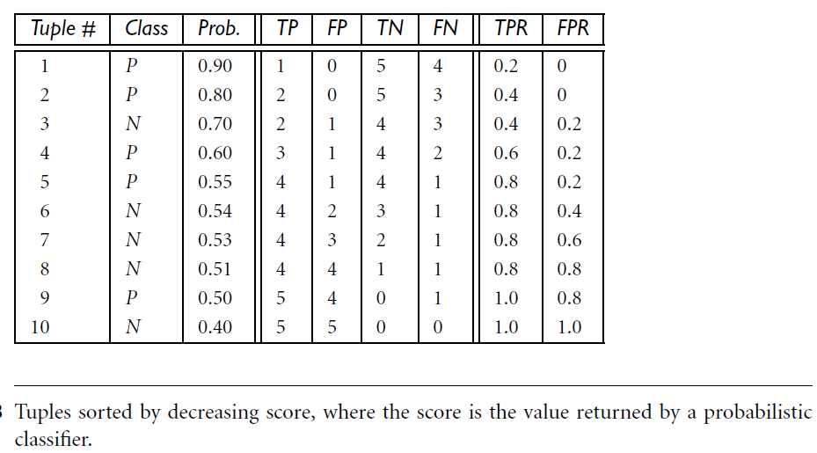
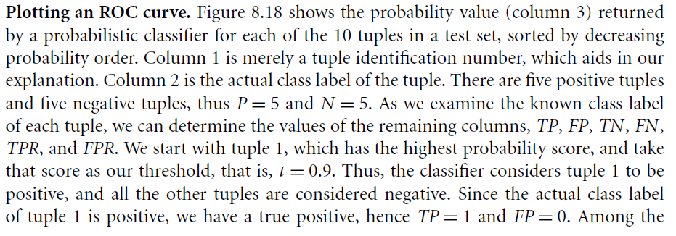
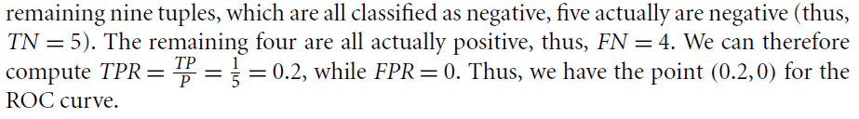
ROC Curves

Slide 42
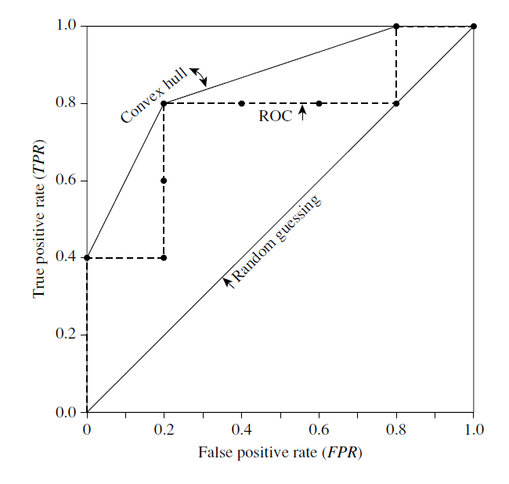
ROC curve for the data

Slide 43
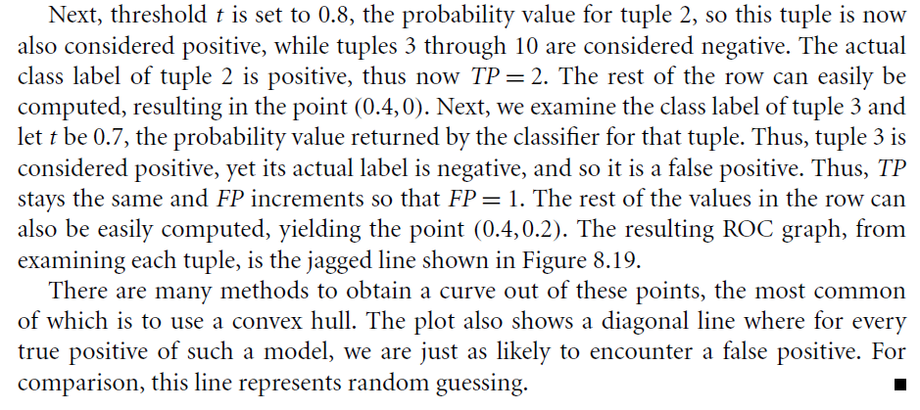
ROC curve for the data

Slide 44
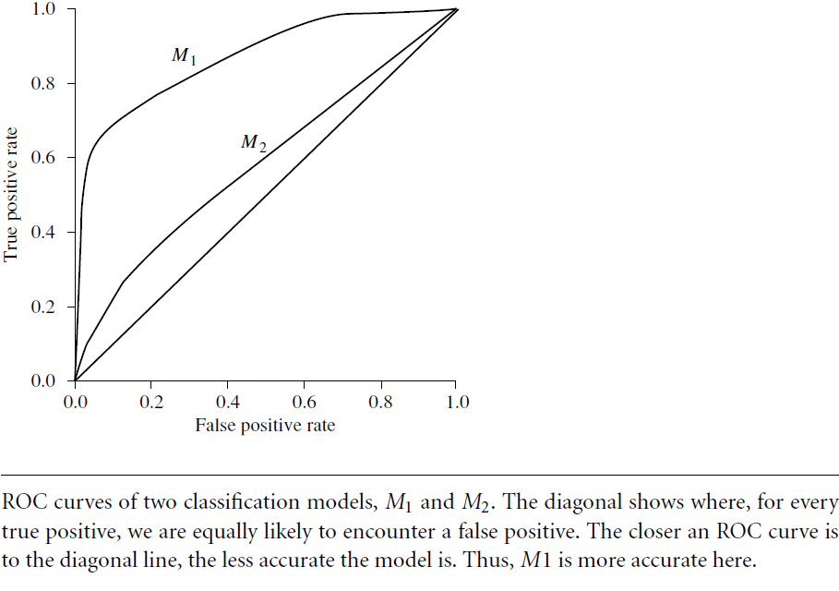
Figure shows the ROC curves of two classification models. The diagonal line representing random guessing is also shown. Thus, the closer the ROC curve of a model is to the diagonal line, the less accurate the model. If the model is really good, initially we are more likely to encounter true positives as we move down the ranked list. Thus, the curve moves steeply up from zero.
Later, as we start to encounter fewer and fewer true positives, and more and more false positives, the curve eases off and becomes more horizontal.
To assess the accuracy of a model, we can measure the area under the curve. The closer the area is to 0.5, the less accurate the corresponding model is. A model with perfect accuracy will have an area of 1.0.

Slide 45
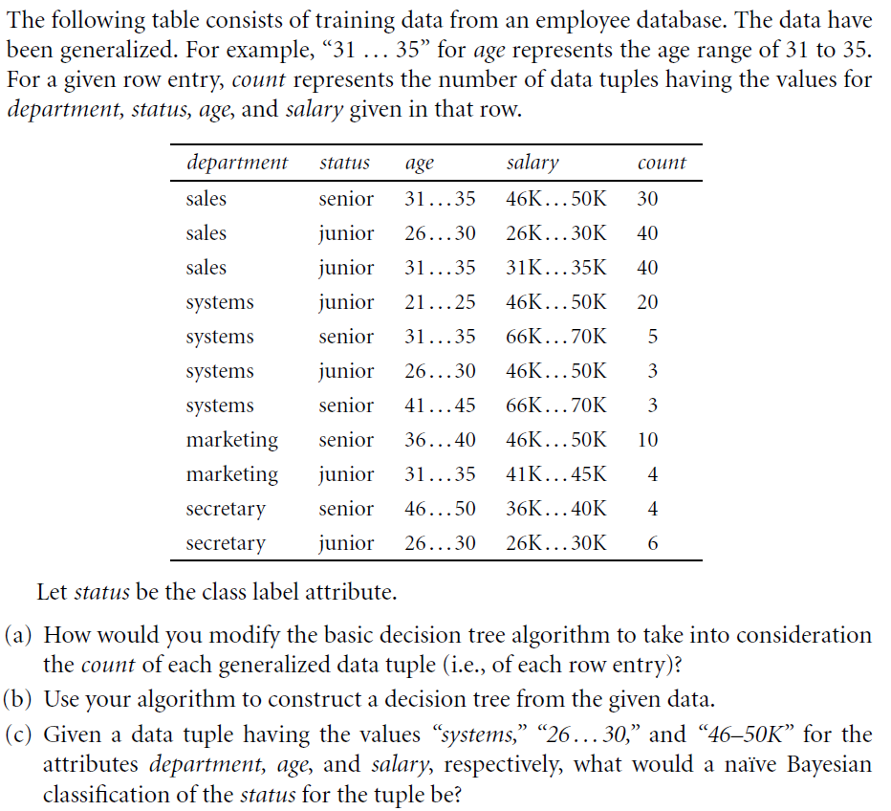
Ex

Slide 46
Issues Affecting Model Selection
Accuracy
  classifier accuracy: predicting class label
Speed
  time to construct the model (training time)
  time to use the model (classification/prediction time)
Robustness: handling noise and missing values
Scalability: efficiency in disk-resident databases
Interpretability
  understanding and insight provided by the model
Other measures, e.g., goodness of rules, such as decision tree size or compactness of classification rules

Slide 48
Rule-Based Classification

Slide 49
Using IF-THEN Rules for Classification
Represent the knowledge in the form of IF-THEN rules
  R: IF age = youth AND student = yes THEN buys_computer = yes
  Rule antecedent/precondition vs. rule consequent
Assessment of a rule: coverage and accuracy
  n_{covers} = # of tuples covered by R
  n_{correct} = # of tuples correctly classified by R
  coverage(R) = n_{covers} /|D| /* D: training data set …antecedents hold */
  accuracy(R) = n_{correct} / n_{covers}
If more than one rule are triggered, need conflict resolution
  Size ordering: assign the highest priority to the triggering rules that has the “toughest” requirement (i.e., with the most attribute tests)
  Rule-based ordering (decision list): rules are organized into one long priority list, according to some measure of rule quality or by experts

Slide 50
Rule Extraction from a Decision Tree
Rules are easier to understand than large trees
One rule is created for each path from the root to a leaf
Each attribute-value pair along a path forms a conjunction: the leaf holds the class prediction
Rules are mutually exclusive and exhaustive
age?
<=30
31..40
>40
student?
yes
credit rating?
no
yes
excellent
fair
no
yes
no
yes
Example: Rule extraction from our buys_computer decision-tree
  IF age = young AND student = no THEN buys_computer = no
  IF age = young AND student = yes THEN buys_computer = yes
  IF age = mid-age THEN buys_computer = yes
  IF age = old AND credit_rating = excellent THEN buys_computer = no
  IF age = old AND credit_rating = fair THEN buys_computer = yes

Slide 51
Recap……Evaluating Classifier Accuracy:
Holdout & Cross-Validation Methods
Holdout method
  Given data is randomly partitioned into two independent sets
    Training set (e.g., 2/3) for model construction
    Test set (e.g., 1/3) for accuracy estimation
  Random sampling: a variation of holdout. Repeat holdout k times, accuracy = avg. of the accuracies obtained

Slide 52
Recap…… Evaluating Classifier Accuracy:
Holdout & Cross-Validation Methods
Cross-validation (k-fold, where k = 10 is most popular)
  Randomly partition the data into k mutually exclusive subsets, each approximately equal size
  At i-th iteration, use D_{i} as test set and others as training set
  each sample is used the same number of times for training and once for testing.
  Leave-one-out: k folds where k = # of tuples, for small sized data (ie only one sample is left out at each trial)
  *Stratified cross-validation*: folds are stratified so that class distribution in each fold is approx. the same as that in the initial data
  In general 10-fold x-validation recommended for estimating accuracy

Slide 53
Recap…… Evaluating Classifier Accuracy: Bootstrap
Bootstrap
  Works well with small data sets
  Samples the given training tuples uniformly with replacement
    i.e., each time a tuple is selected, it is equally likely to be selected again and re-added to the training set
Several bootstrap methods, and a common one is .632 boostrap
  A data set with d tuples is sampled d times, with replacement, resulting in a training set of d samples.
  The data tuples that did not make it into the training set end up forming the test set.
  About 63.2% of the original data end up in the bootstrap, and the remaining 36.8% form the test set (since (1 – 1/d)^{d} ≈ e⁻¹ = 0.368)

Slide 54

Ensemble Methods: Increasing the Accuracy
Ensemble methods
  Use a combination of models to increase accuracy
  Combine a series of k learned models, M₁, M₂, …, M_{k}, with the aim of creating an improved model M*
Popular ensemble methods
  Bagging: averaging the prediction over a collection of classifiers
  Boosting: weighted vote with a collection of classifiers
  Ensemble: combining a set of heterogeneous classifiers

Slide 55
Bagging: Boostrap Aggregation
Analogy: Diagnosis based on multiple doctors’ majority vote
Training
  Given a set D of d tuples, at each iteration i, a training set D_{i} of d tuples is sampled with replacement from D (i.e., bootstrap)
  A classifier model M_{i} is learned for each training set D_{i}
Classification: classify an unknown sample X
  Each classifier M_{i} returns its class prediction
  The bagged classifier M* counts the votes and assigns the class with the most votes to X
Prediction: can be applied to the prediction of continuous values by taking the average value of each prediction for a given test tuple
Accuracy
  Often significantly better than a single classifier derived from D
  Proved improved accuracy in prediction

Slide 56
Boosting
Analogy: Consult several doctors, based on a combination of weighted diagnoses—weight assigned based on the previous diagnosis accuracy
How boosting works?
  Weights are assigned to each training tuple
  A series of k classifiers is iteratively learned
  After a classifier M_{i} is learned, the weights are updated to allow the subsequent classifier, M_{i+1}, to pay more attention to the training tuples that were misclassified by M_{i}
  The final M* combines the votes of each individual classifier, where the weight of each classifier's vote is a function of its accuracy
Boosting algorithm can be extended for numeric prediction
Comparing with bagging: Boosting tends to have greater accuracy, but it also risks overfitting the model to misclassified data

Slide 57
Random Forest (Breiman 2001)
Random Forest:
  Each classifier in the ensemble is a decision tree classifier and is generated using a random selection of attributes at each node to determine the split
  During classification, each tree votes and the most popular class is returned
Two Methods to construct Random Forest:
  Forest-RI (random input selection): Randomly select, at each node, F attributes as candidates for the split at the node. The CART methodology is used to grow the trees to maximum size
  Forest-RC (random linear combinations): Creates new attributes (or features) that are a linear combination of the existing attributes (reduces the correlation between individual classifiers)
More robust to errors and outliers

Slide 58
Classification of Class-Imbalanced Data Sets
Class-imbalance problem: Rare positive example but numerous negative ones, e.g., medical diagnosis, fraud, oil-spill, fault, etc.
Traditional methods assume a balanced distribution of classes and equal error costs: not suitable for class-imbalanced data
Typical methods for imbalance data in 2-class classification:
  Oversampling: re-sampling of data from positive class
  Under-sampling: randomly eliminate tuples from negative class
  Threshold-moving: moves the decision threshold, t, so that the rare class tuples are easier to classify, and hence, less chance of costly false negative errors
  Ensemble techniques: Ensemble multiple classifiers introduced above
Still difficult for class imbalance problem on multiclass tasks

Slide 59
Model Evaluation and Selection

Slide 60
How do you know which classifier to choose?
Runtime
First, how long it takes to update a model, and
Second, how long it takes to use a model to actually make a decision….. This kind of consideration is usually more important and is called runtime.
Some algorithms are slow at runtime.
  Consider k-NN: given a new data point in some large-dimensional space, find the k closest data points to it.
  In particular, need to have all data points in memory.
Advantage Linear models:
  Very fast, both to update and to use at runtime.
  Can keep running estimates of the constituent parts and just update with new data, which is fast and doesn’t require holding old data in memory.
Once you have a linear model, it’s just a matter of storing the coefficient vector in a runtime machine and doing a single dot product against the user’s feature vector to get an answer.
Interpretability
You often need to be able to interpret your model for the sake of the business.
Decision trees are very easy to interpret.
Random forests, on the other hand, are not, even though they are almost the same thing.

Slide 61
How do you know which classifier to choose?
Scalability - there are three things to keep in mind when considering scalability:
1. Learning time: How much time does it take to train the model?
2. Scoring time: How much time does it take to give a new user a
score once the model is in production?
3. Model storage: How much memory does the production model use up?
Refer a useful paper to look at when comparing models: An Empirical Comparison of Supervised Learning Algorithms:
  Simpler models are more interpretable but aren’t as good performers.
  The question of which algorithm works best is problem dependent
  It’s also constraint-dependent.

Slide 62
Summary (I)
Classification is a form of data analysis that extracts models describing important data classes.
Effective and scalable methods have been developed for decision tree induction, Naive Bayesian classification, rule-based classification, and many other classification methods.
Evaluation metrics include: accuracy, sensitivity, specificity, precision, recall, F measure, and F_{ß} measure.
Stratified k-fold cross-validation is recommended for accuracy estimation. Bagging and boosting can be used to increase overall accuracy by learning and combining a series of individual models.

Slide 63
Summary (II)
Significance tests and ROC curves are useful for model selection.
There have been numerous comparisons of the different classification methods; the matter remains a research topic
No single method has been found to be superior over all others for all data sets…now Deep learning is seen to be superior
Issues such as accuracy, training time, robustness, scalability, and interpretability must be considered and can involve trade-offs, further complicating the quest for an overall superior method

Slide 64
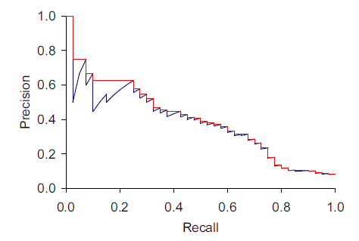
Precision and Recall
Search tools and classifiers normally assign scores to items. Sorting by score gives us a precision-recall plot which shows what performance would be for different score thresholds.
Score increasing

Slide 65
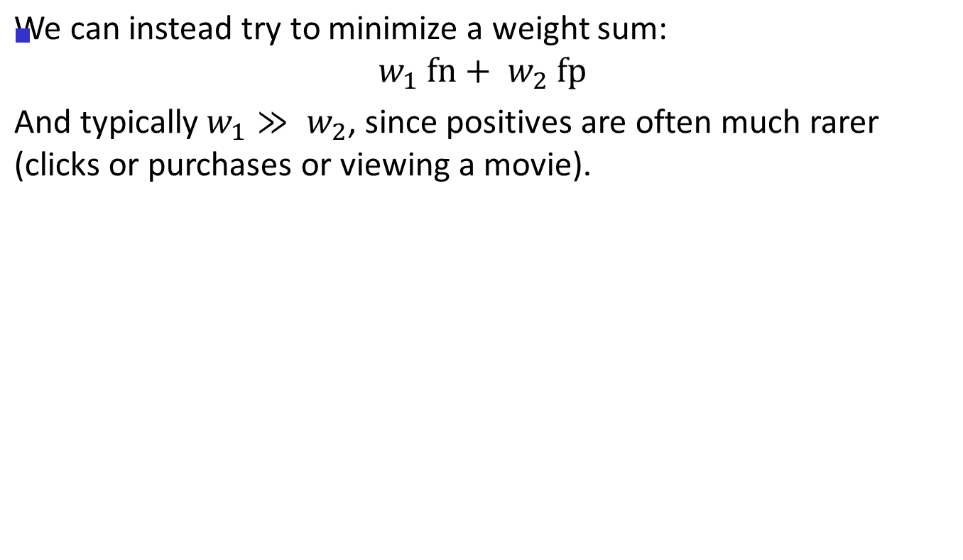
Weighted loss

Slide 66
Interpolated Recall
The true precision plot (blue) necessarily dips at high precision each time a fp appears in the item ordering. These can be removed by using “interpolated precision” which is defined as the max precision at any recall value r’ > the current r. An interpolated precision-recall curve is non-increasing.

Slide 67
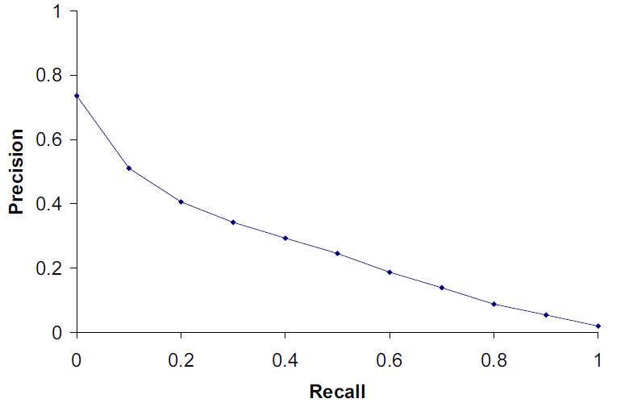
TREC Precision-Recall plots
We compute the interpolated precision values at ten values of recall, 0.1, 0.2,… 1.0.

Slide 68


Adaboost (Freund and Schapire, 1997)
Given a set of d class-labeled tuples, (X₁, y₁), …, (X_{d}, y_{d})
Initially, all the weights of tuples are set the same (1/d)
Generate k classifiers in k rounds. At round i,
  Tuples from D are sampled (with replacement) to form a training set D_{i} of the same size
  Each tuple’s chance of being selected is based on its weight
  A classification model M_{i} is derived from D_{i}
  Its error rate is calculated using D_{i} as a test set
  If a tuple is misclassified, its weight is increased, else decreased
Error rate: err(X_{j}) is the misclassification error of tuple X_{j}. Classifier M_{i} error rate is the sum of the weights of the misclassified tuples:
The weight of classifier M_{i}’s vote is

